Slide 1
BRAJESH KUMAR SHARMA
ASST. PROFESSOR(CSE)
SPSU,UDAIPUR

Slide 2
Contents
DES Overview
Double DES
Triple DES with 2-key encryption
Triple DES with 3-key encryption

Slide 3
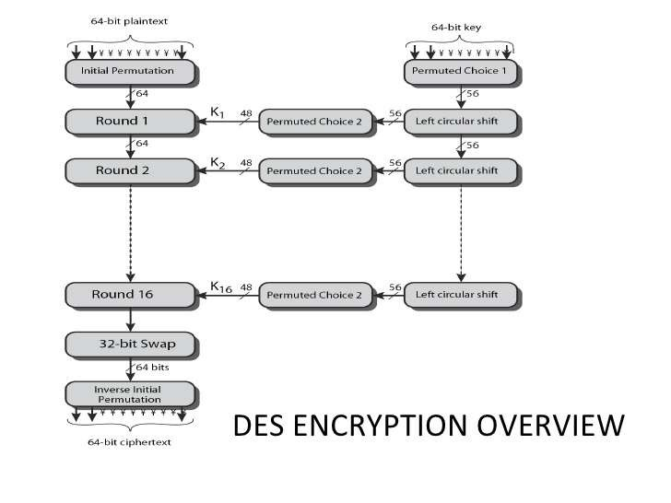
DES Overview

Slide 4
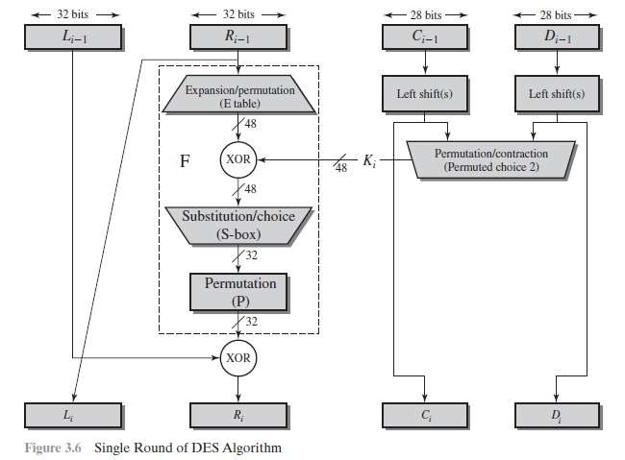
DES Overview

Slide 5
Double DES
In this approach, we use two instances of DES ciphers for encryption and two instances of reverse ciphers for decryption.
Each instances use a different key.
The size of the key is doubled.
There are issues of reduction to single stage.
However, double DES is vulnerable to meet-in-the-middle attack.

Slide 6
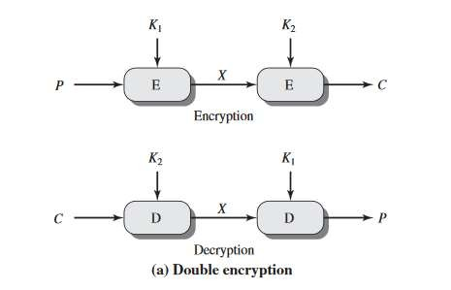
Double DES
Given a plaintext P and two encryption keys 𝐾₁ and 𝐾₂, a cipher text can
be generated as,
C = E(𝐾₂, E(𝐾₁, P))
Decryption requires that the keys be applied in reverse order,
P = D(𝐾₁, D(𝐾₂, C))

Slide 7
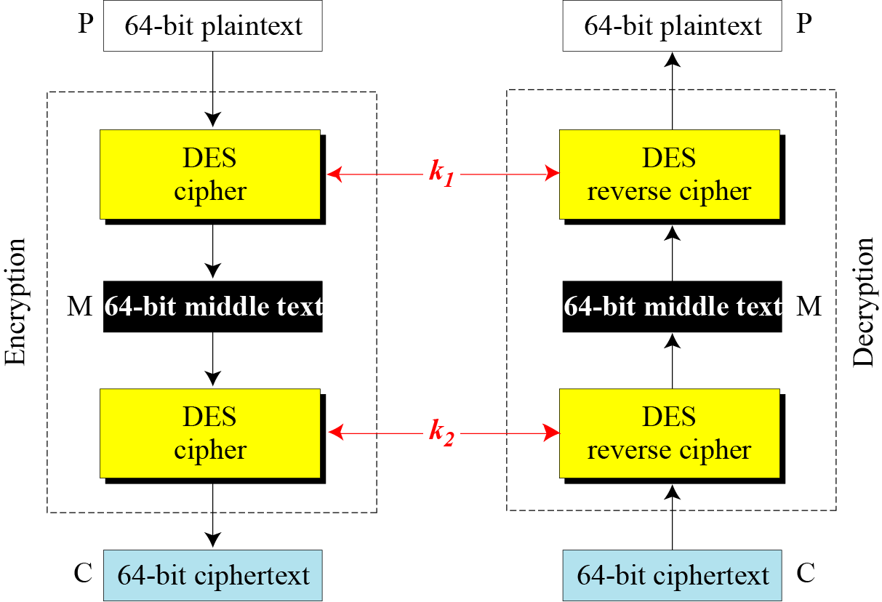
Meet-in-the-middle attack

Slide 8
Meet-in-the-middle attack
The middle text, the text created by the first encryption or the first decryption, M, should be same
M = 𝐸_{𝐾1}(P) M = 𝐷_{𝐾2}(C)
Encrypt P using all possible values of 𝐾₁ and records all values obtained for M.
Decrypt C using all possible values of 𝐾₂ and records all values obtained for M.
Create two tables sorted by M values.
Now compares the values for M until we finds those pairs of 𝐾₁ & 𝐾₂ for which the value of M is same in both tables.

Slide 9
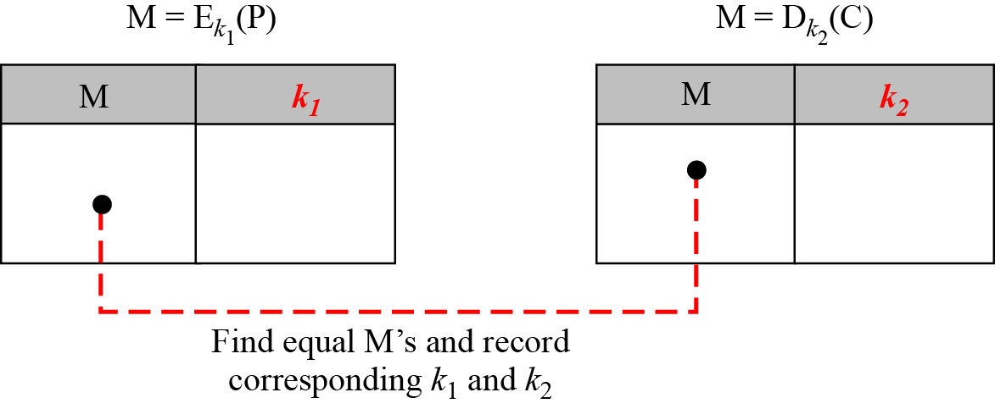
Meet-in-the-middle attack
Instead of using 2¹¹² key search tests, we have to use 2⁵⁶ key search tests two times.
Moving from a Single DES to Double DES, we have to increased the strength from 2⁵⁶ to 2⁵⁷.

Slide 10
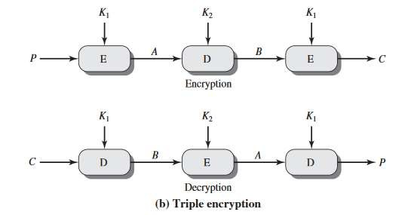
Triple DES with 2-key
Use three stages of DES for encryption and decryption.
The 1st, 3rd stage use 𝐾₁ key and 2nd stage use 𝐾₂ key.
To make triple DES compatible with single DES, the middle stage uses decryption in the encryption side and encryption in the decryption side.
It’s much stronger than double DES.

Slide 11
Triple DES with 2-key
The function follows an encrypt-decrypt-encrypt (EDE) sequence.
C = E(𝐾₁, D(𝐾₂, E(𝐾₁, P)))
P = D(𝐾₁, E(𝐾₂, D(𝐾₁, C)))
By the use of triple DES with 2-key encryption, it raises the cost of meet- in-the-middle attack to 2¹¹².
It has the drawback of requiring a key length of 56 × 3 = 168bits which
may be somewhat unwieldy.

Slide 12
Triple DES with 3-key
Although the attacks just described appear impractical, anyone using two- key 3DES may feel some concern.
Thus, many researches now feel that 3-key
alternative.
Use three stages of DES for encryption and decryption with three different keys.
3-key 3DES has an effective key length of 168 bits and is defined as,
C = E(𝐾₃, D(𝐾₂, E(𝐾₁, P)))
P = D(𝐾₁, E(𝐾₂, D(𝐾₃, C)))
3DES is the preferred

Slide 13
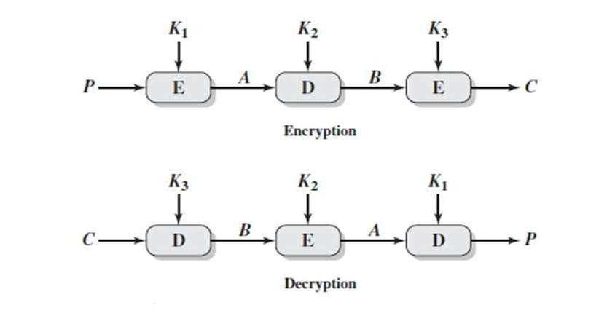
Triple DES with 3-key

Slide 14



